Slide 1
Category review: Chips
June 2024
Retail Analytics
Brand note: If client logo is not required, use alternate title page layout right click slide thumbnail > Layout > Title

Slide 2
Notes:
To view Privacy video explaining how important data privacy is to Quantium, please click here: https://www.youtube.com/watch?v=Zq1QDAkoRzU
or here Q:\Company Reference\Brand & Design\Brand videos\Q Privacy.mp4
At Quantium, we believe that data is the behavioural footprint of humanity and that it has to be treated with the utmost care and responsibility.
Histories, attitudes, indeed lives are stored within it in ways that aren’t always apparent – and that’s what makes its potential so powerful.
To work with it responsibly, sensitively, we set ourselves the highest data privacy protection and governance standards.
We have spent 17 years perfecting privacy-by-design and secure-by-design principles. Central to this is not holding any personally identifiable information about people –
we neither receive it, and put the necessary protections in place to be unable to decipher it.
Every aspect of handling data is safeguarded: from its de-identification, to its encryption – data security is paramount and of the highest grade.
We pride ourselves on gaining the trust of iconic organisations around the world through years of securely working with their data,
and in turn the trust that builds with their stakeholders.

Slide 3
Executive summary
01
Customer Analysis
The three highest contributing segments to total sales are: 1. Budget older families , 2. Mainstream Young singles/couples , 3. Mainstream Retirees
Factors dividing sales: older families have largest average number of packets purchased per customer while the mainstream young singles/ couples have largest population.
To target in the store strategy mainstream young singles/couples are more likely to purchase tyrells chips and other segments.
02
Trail Store Analysis
A trail of changing the store layout was implemented in three stores.
A control store was constructed to reflect the prior performance of the selected trial store.
The trail show a significant increase the total sales and number of customers with a new store layout.

Slide 4
01
Customer Analytics

Slide 5
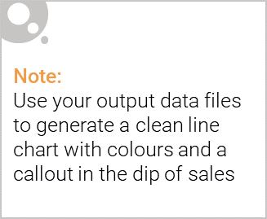
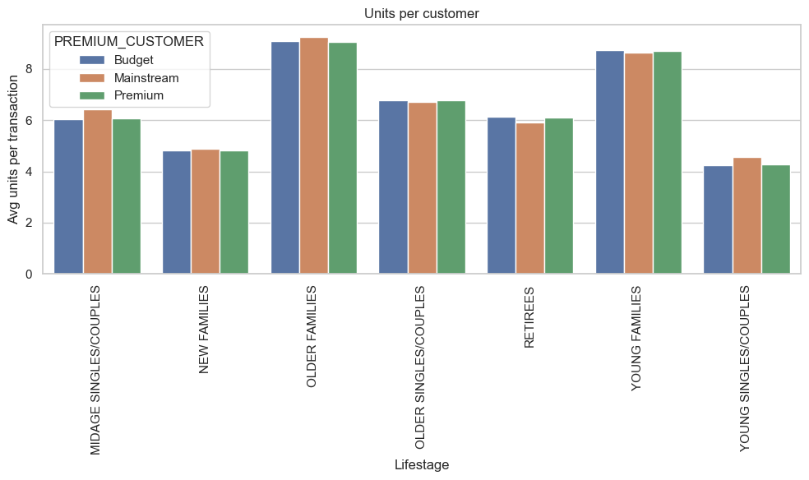
Older and Young families purchase more chips on average than the other groups

Slide 6
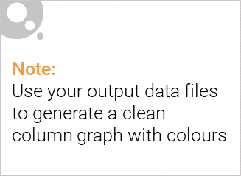
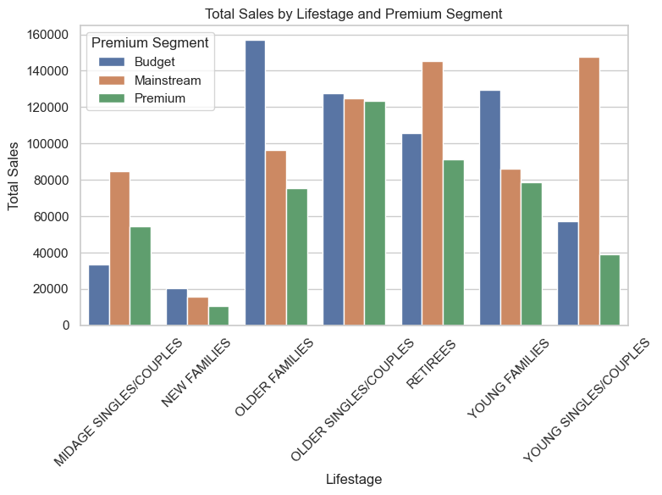
Sales are coming mostly from budget older families followed by mainstream young singles/couples

Slide 7
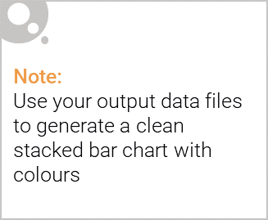
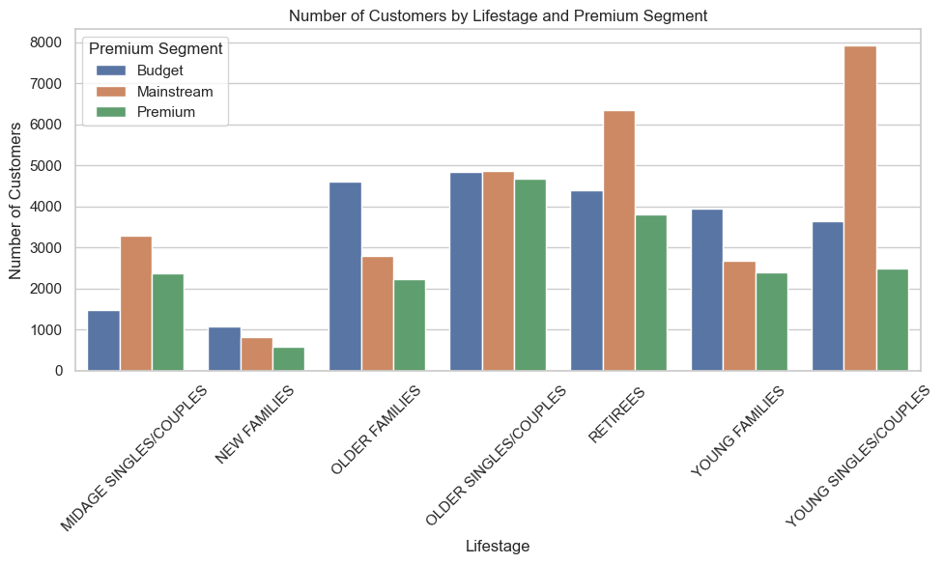
Editable (delete this)
Mainstream young singles/couples have the largest population driving their sales

Slide 8
02
Trial Store Performance

Slide 9
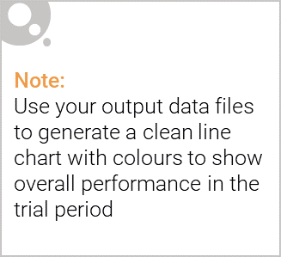
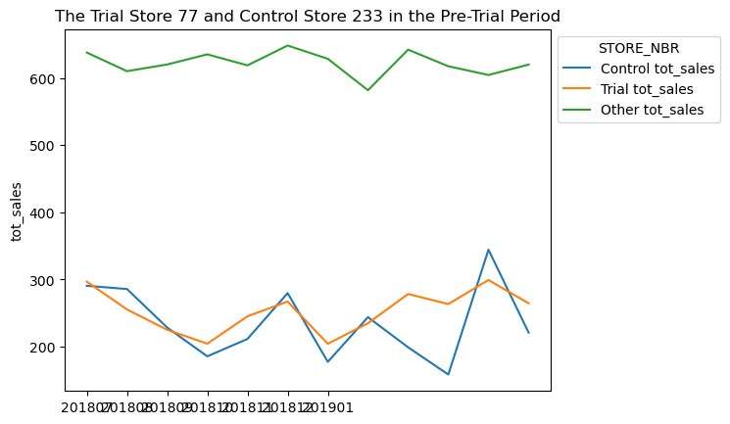
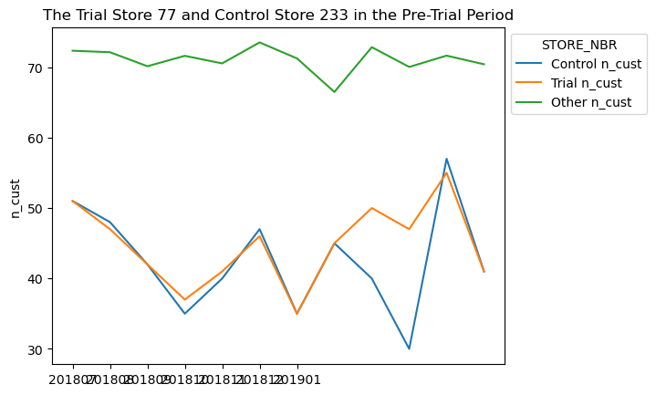
The control store is constructed to reflect performance of the trail store rather than the average of other stores[Stores 77 and 233]

Slide 10
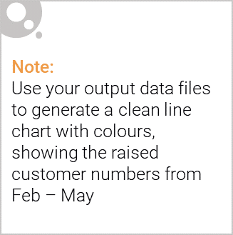
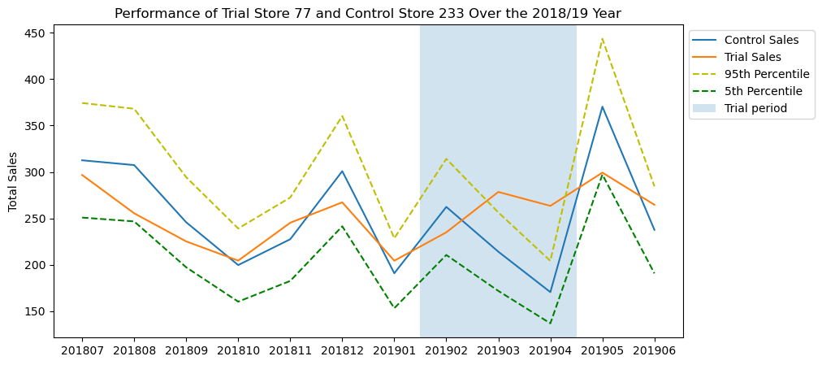
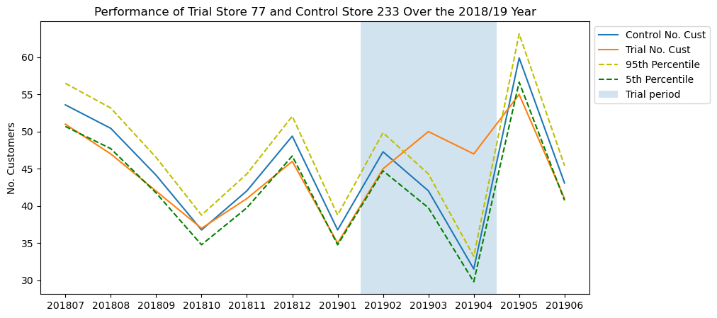
Trail store 77 and Control store 233: trail success ,with increase in sales and number of customers

Slide 11
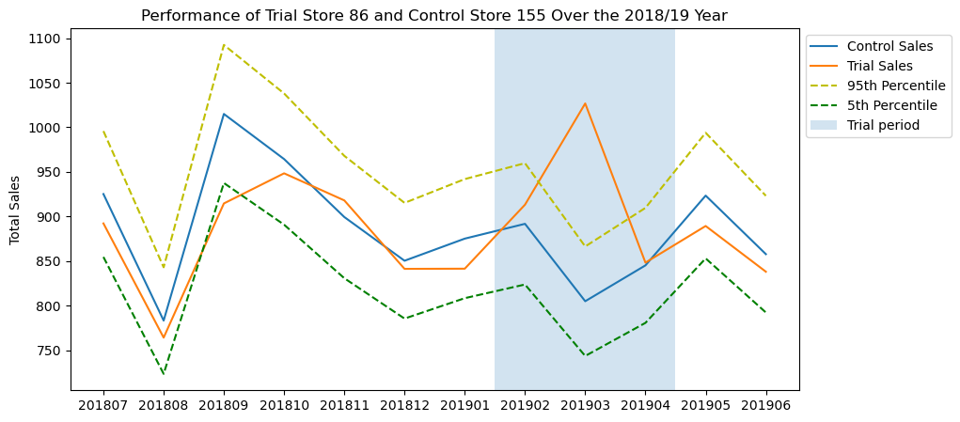
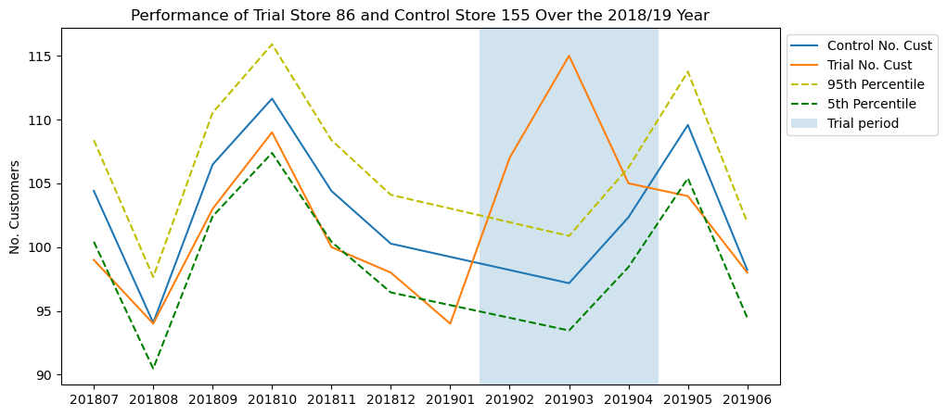
Trail store 86 and control store 155: trail success ,with increase in sales and number of customers

Slide 12
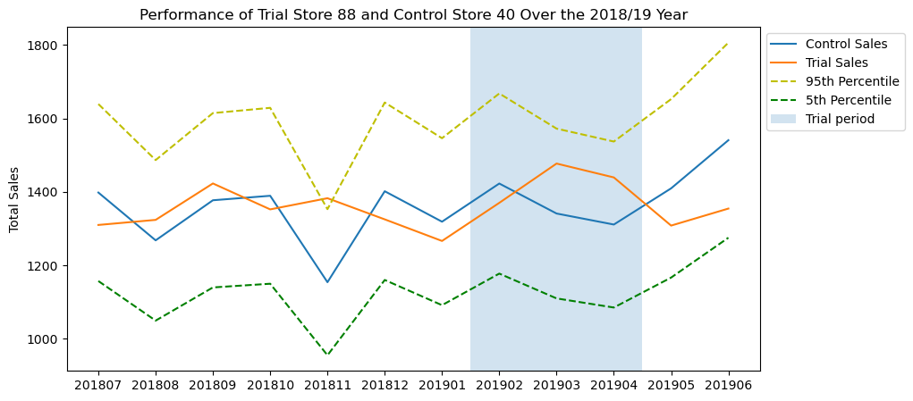
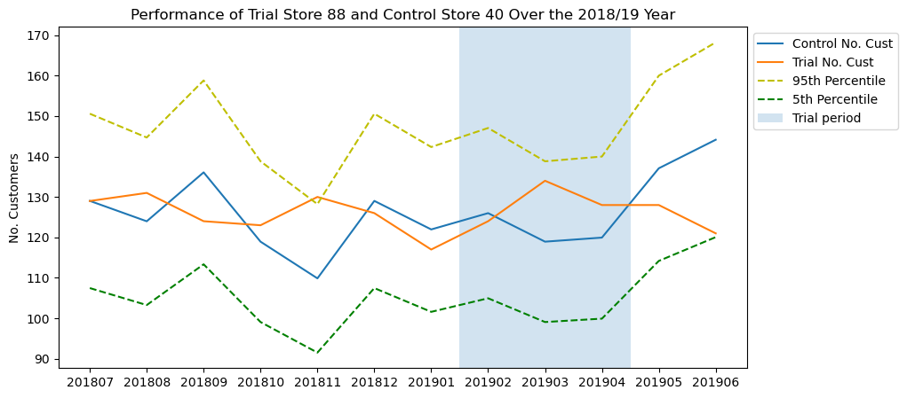
Trail store 88 and control store 40: No significant difference in performance

